Slide 1
Diversity and Equity at CAL POLY
Hanna Wierszok, Ruojia Kuang

Slide 2
01
02
03
04
Variety of cultures
DIVERSE, EQUITABLE, ANd Inclusive community
Diversity of complex and intersecting identities
Seeks to mirror the diversity and demographics of California
Funds distribution to college/division

Slide 3
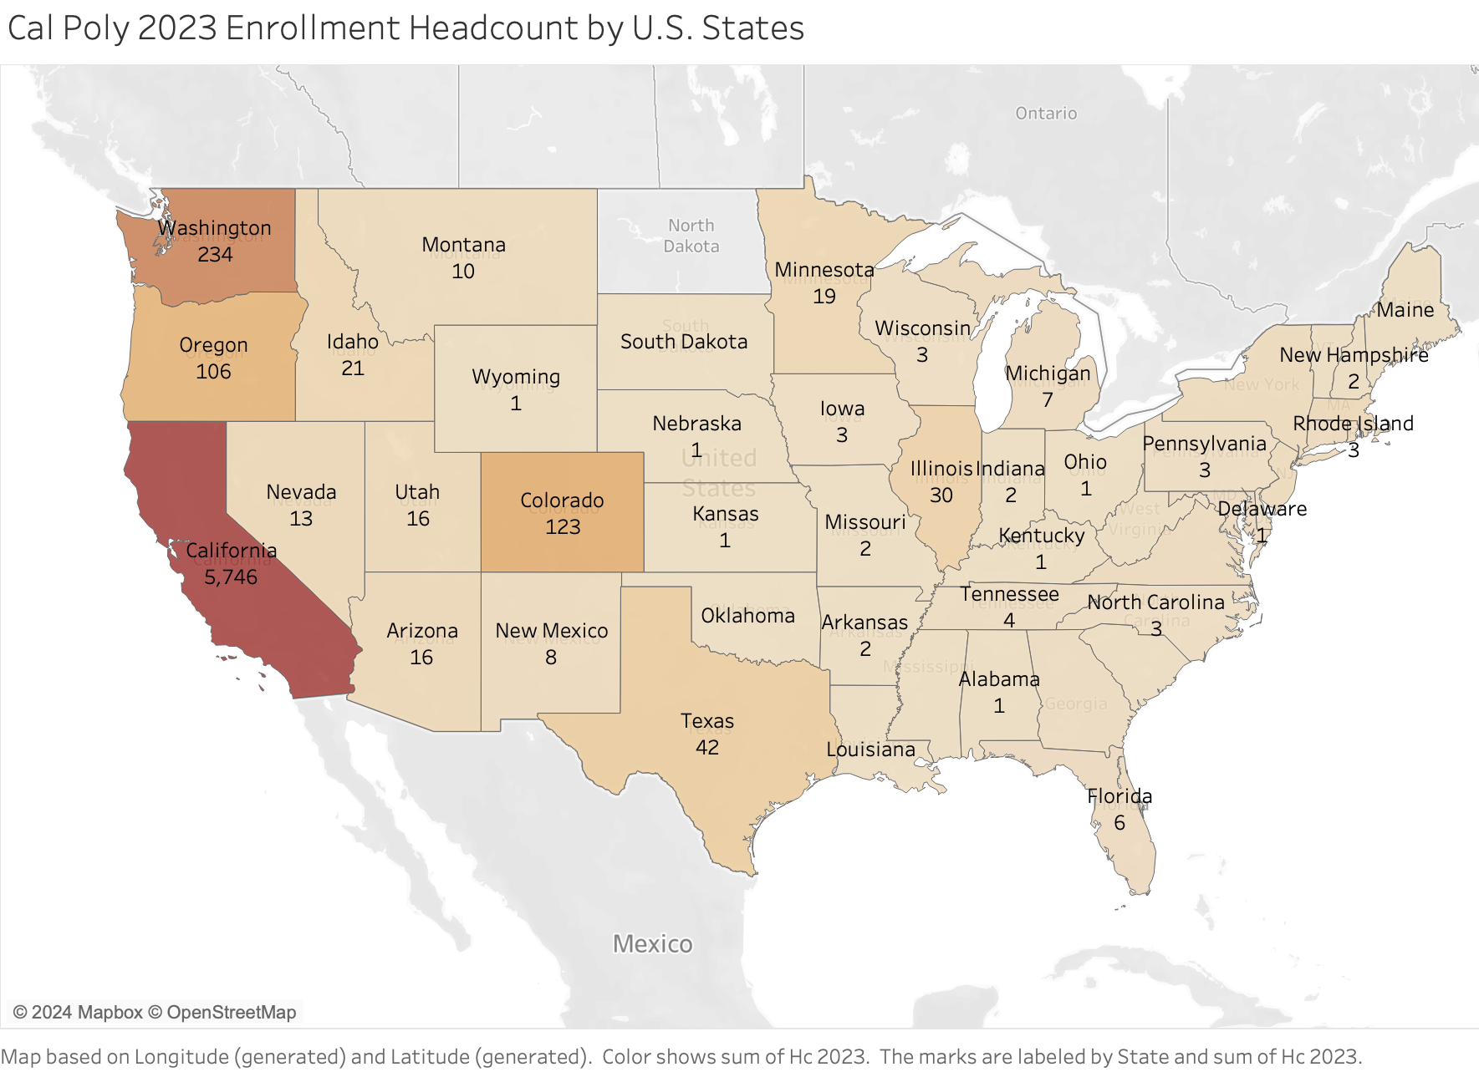
Geographic map of school enrollment

Slide 4
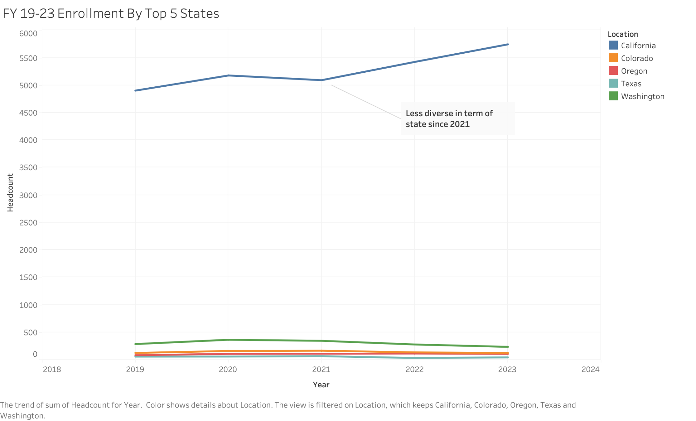
Trending of Top 5 Enrollment States

Slide 5
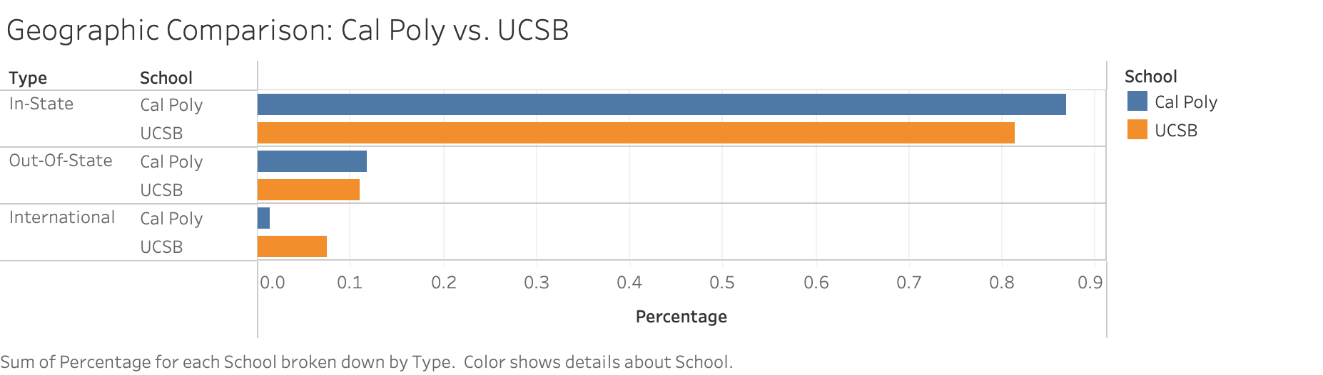
Geographic Diversity
UCSB Ranks 798 out of 2,183 when it comes to geographic diversity
According to collegefaculty.com,

Slide 6
the importance of diversity
40% - Latino, 35% - white, 15% - Asian American or Pacific Islander, 5% - Black, 4% - multiracial, less than 1% - Native American or Alaska Natives.
According to Public Policy Institute of California
Understanding and comparing ethnic diversity at Cal Poly and UCSB to identify trends and potential areas for improvement

Slide 7
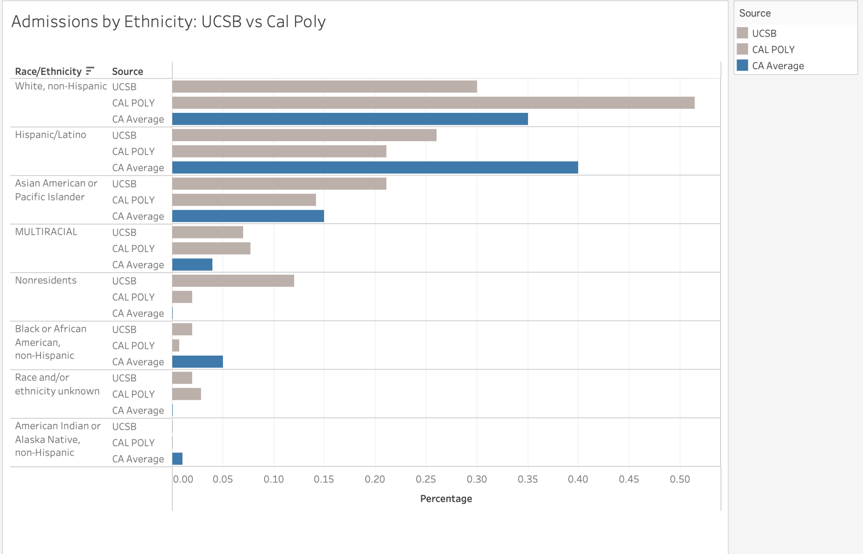

Slide 8
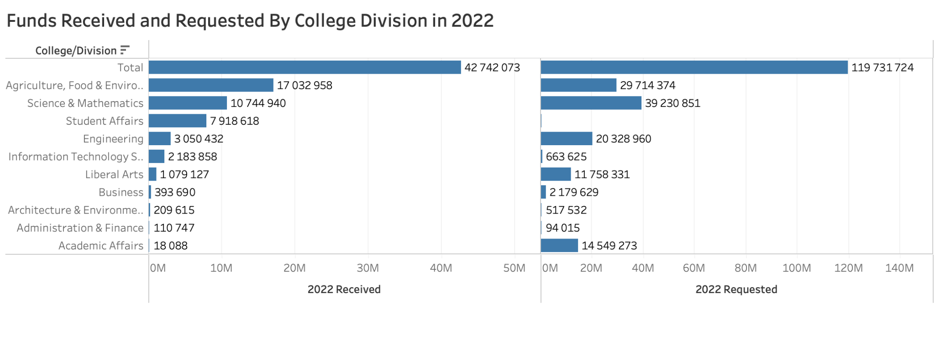

Slide 9
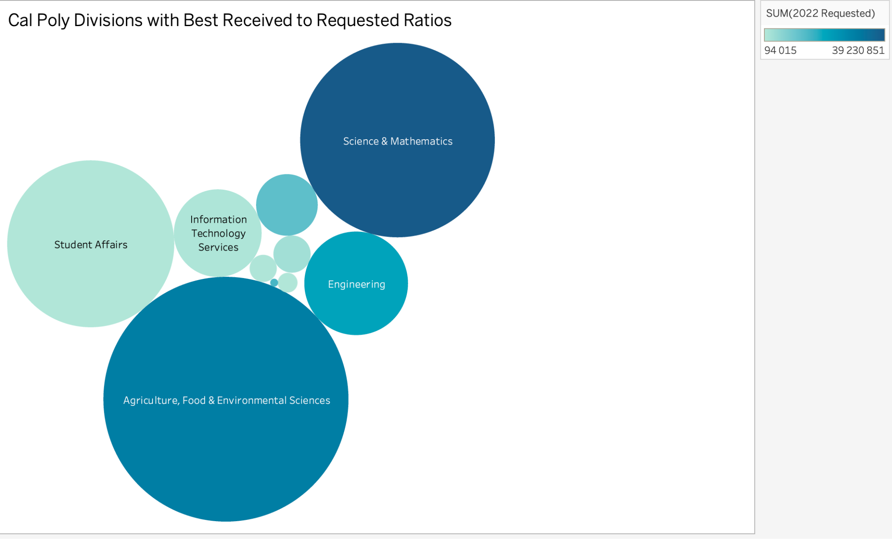
Agriculture, Food & Environmental Sciences
Science & Mathematics
Student Affairs
Engineering
Information Technology Services

Slide 10
conclusion
Diversity Emphasis
Out-of-State Recruitment
Beyond Agriculture
Funding Allocation

Slide 11
THANKS
Does anyone have any questions?

